Slide 1
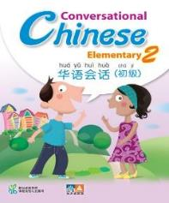

华语会话 初级 Conversational Chinese – Elementary (13-16 years old)
适合非华族中学学生
学生能透过此系列学习华文文化与价值观念
帮助学生更好地与华人同胞建立融洽和谐的关系
着重于沟通
适于补充课程
Non-Chinese Secondary students learning Chinese as a third language
Students can learn the Chinese culture and values through the series
Helps forge harmony and cohesion with the Chinese
Focuses on communication skills
Suitable as enrichment programme

